Slide 1
Big Mountain Ticket Price Analysis
By Brian Stern

Slide 2
Key Issues
Big Mountain investing in a new chair lift
Increases operating costs by $1,540,000
How can Big Mountain maximize its facilities to match the increase in operating costs?

Slide 3
Recommendations and Key Findings
Increase vertical drop by 150 feet adding a new run
Install a new chair lift
Justifies an $8.46 increase in ticket prices
Given 350,000 visitors, revenues would rise by just under $15 million
Could be paired with closures of the least used to runs to minimize operating costs
More cost effective to close one, five, or eight runs
Most important features:
Vertical drop, snow making ac, total chairs, fast quads, runs and longest run

Slide 4
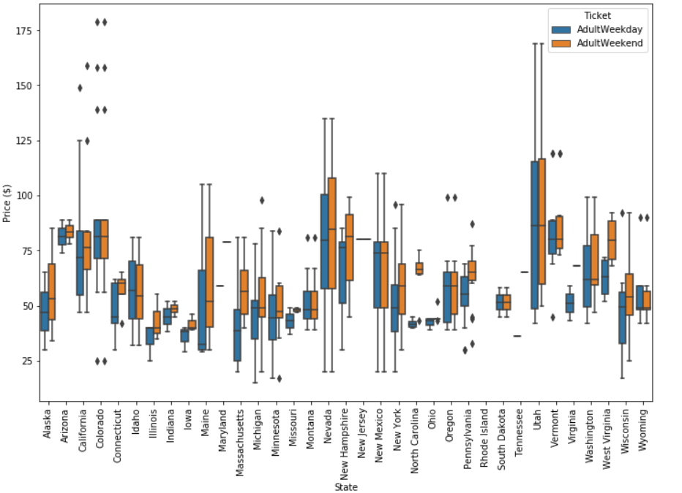
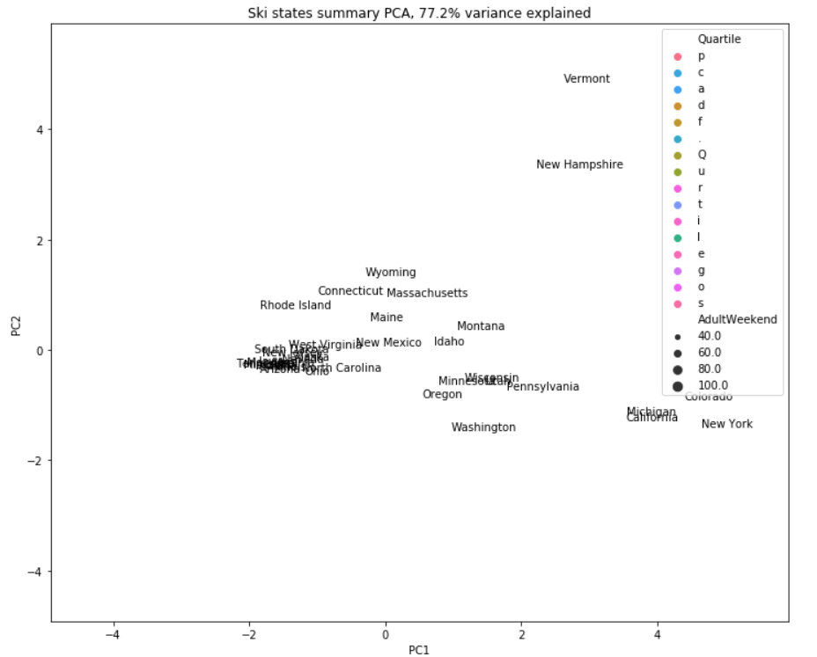
Models and Analysis
No strong correlation between ticket prices and states
Vermont and New Hampshire strongly impacted by very high resort per capita value

Slide 5
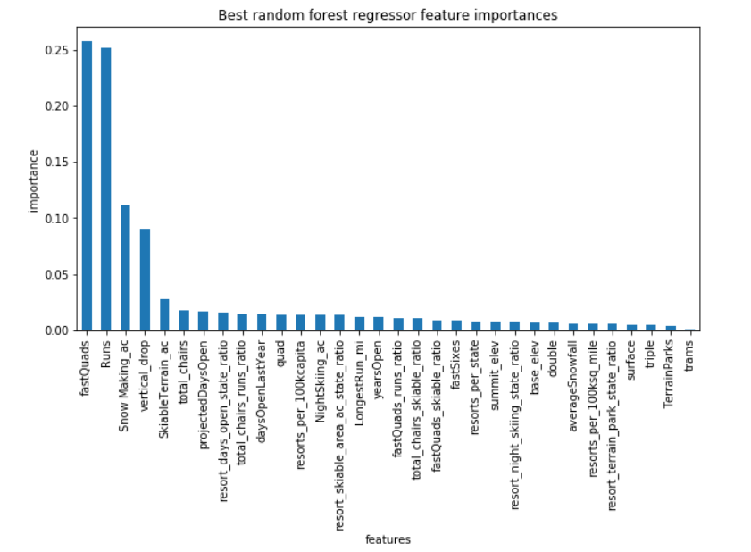
Model Training Results
Most important features through modeling:
Fast Quads
Total Runs
Snow Making
Vertical Drop
Current Features supports $94.22 ticket
Increases revenue by $23 million

Slide 6
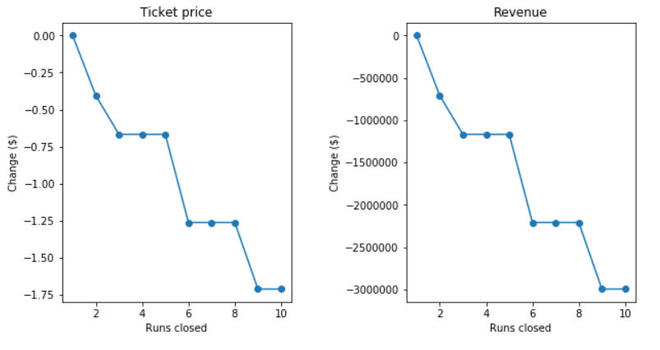
Ticket Price Modeling
Closures of least used runs would help reduce operating costs
Closing one run supports the same ticket price
Closing 3-5 runs would necessitate a decrease of $0.66 and revenue by $1.2 million
Closing 5-8 runs would necessitate a decrease of $1.26 and revenue by $2.2 million

Slide 7
Summary
Adult Weekend ticket of $81 can be increased to $94.22 based on current features
Increase in ticket price can be justified by installation of chair lift
Second scenario proposed would increase revenue by $15 million
Can reduce operating costs by removing 1 or 5 of the least used runs

